Slide 1
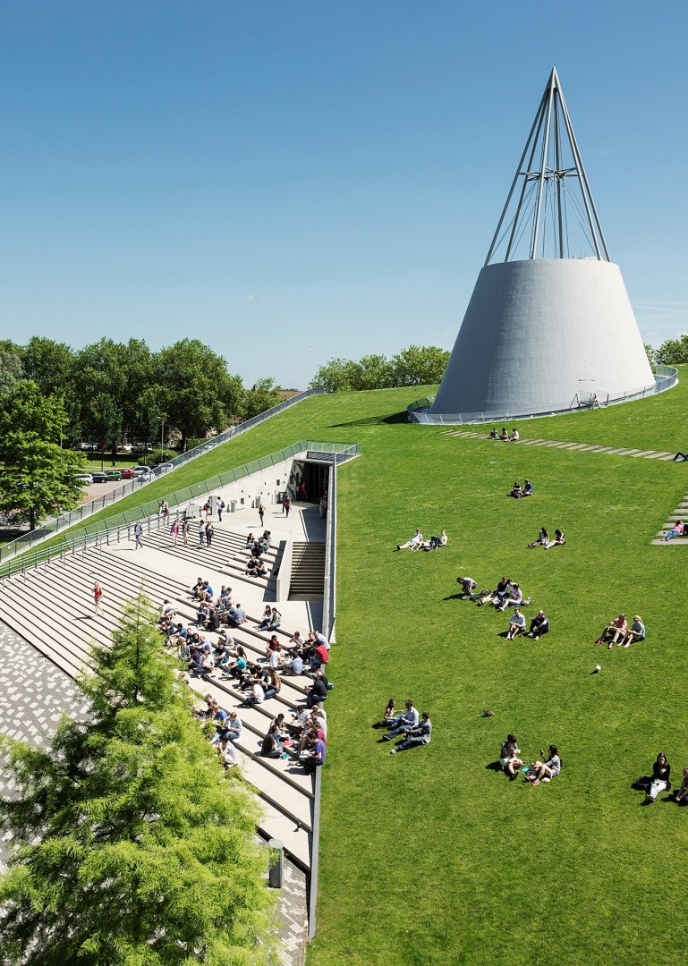
Title slide + image
LiDAR-Enhanced Closed Loop Wake Mixing Control
David Chen

Slide 2

Table of Content
Introduction
Feedback --- LiDAR
Research Question
Control Design
Current Progress
Future Work
Q & A

Slide 3
Chapter | dark mode
00
Introduction
Wake, WFFC, Helix

Slide 4
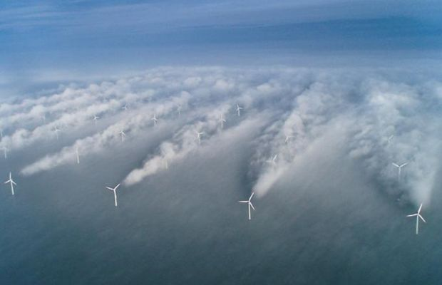
Introduction --- Wake Effect
Effect on downstream WT:
Less power production
Increase structural loads
20 – 45% Loss of Energy
Notes:
The downstream turbine encounters a significantly reduced free-stream velocity compared to the upstream turbine, leading to less energy being available in the flow.

Slide 5
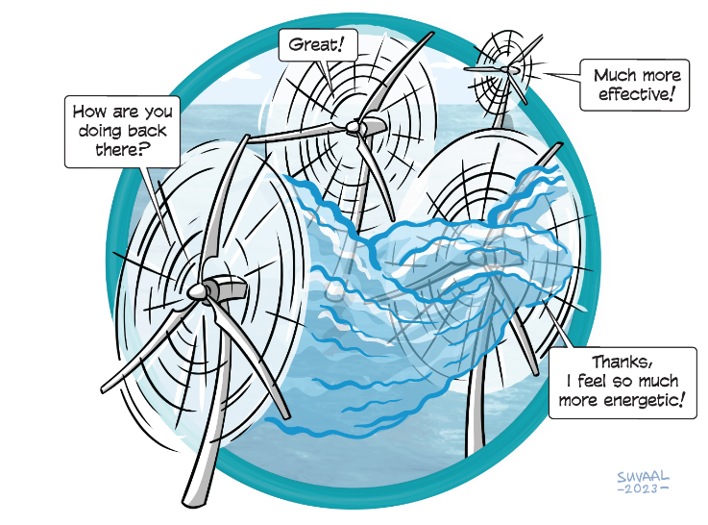
Introduction --- Wind Farm Flow Control
Axial Induction Control
Wake Steering
Wake Mixing

Slide 6
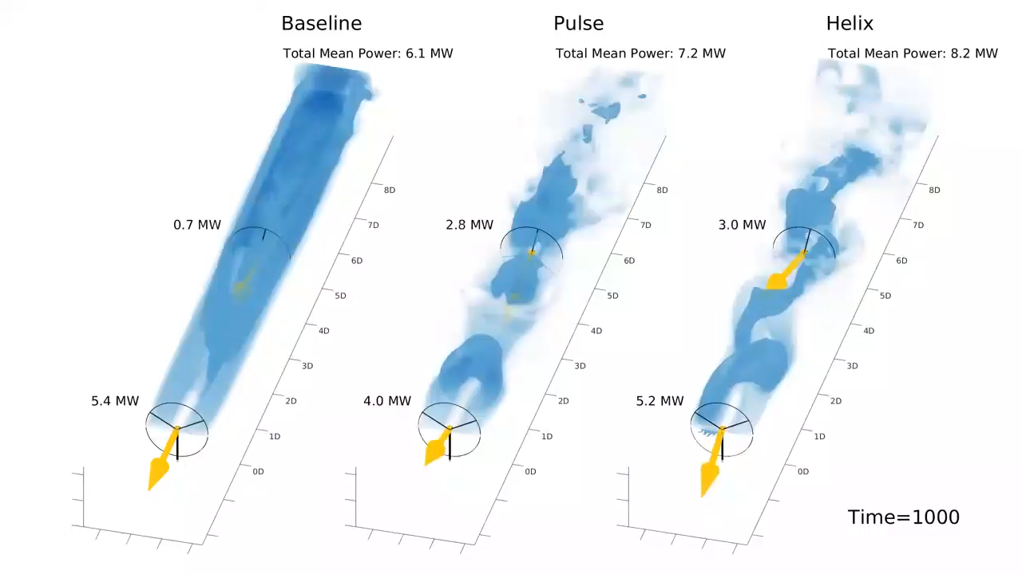
Introduction --- Wake Mixing
Facilitate mixing of free-ambient air and wake for wake recovery
Notes:
The arrow stands for the thrust force
Facilitate mixing of free-ambient air and wake for wake recovery

Slide 7
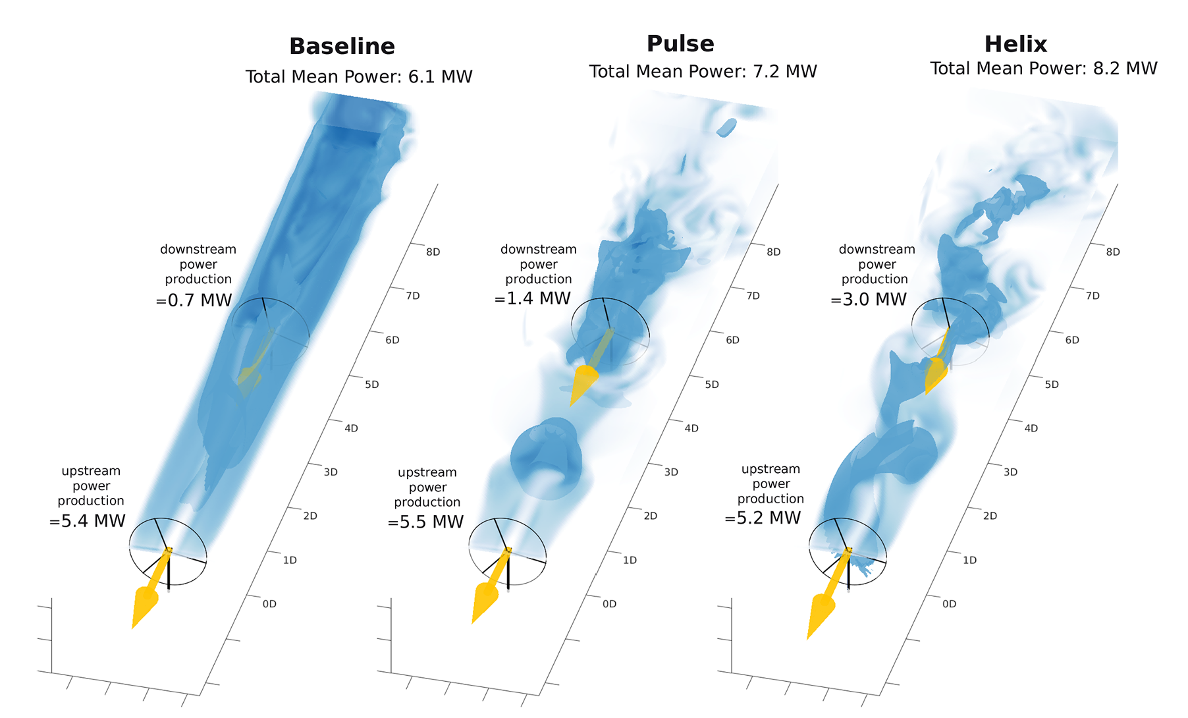
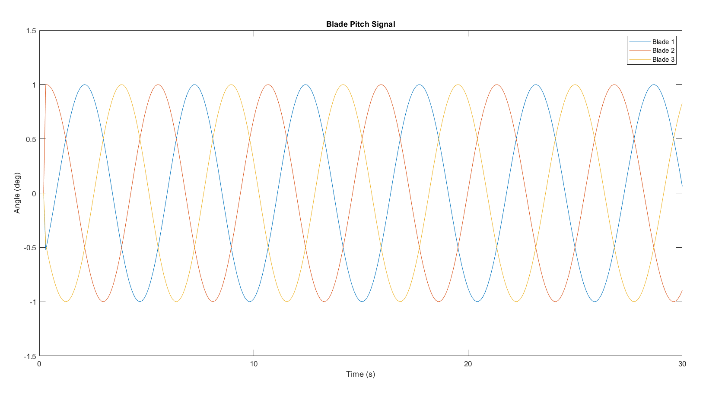
Introduction --- Helix Approach
Notes:
The wake mixing control strategy is developed to enhance the mixing of the turbine’s wake with ambient free-stream velocity air. This enhanced mixing accelerates the energy recovery of the wake more effectively than would occur through natural wake processes and recovery mechanisms.
Pulse: varying thrust coefficient sinusoidal ----> Load ----> More consistent
Helix: Individual Pitch Control

Slide 8
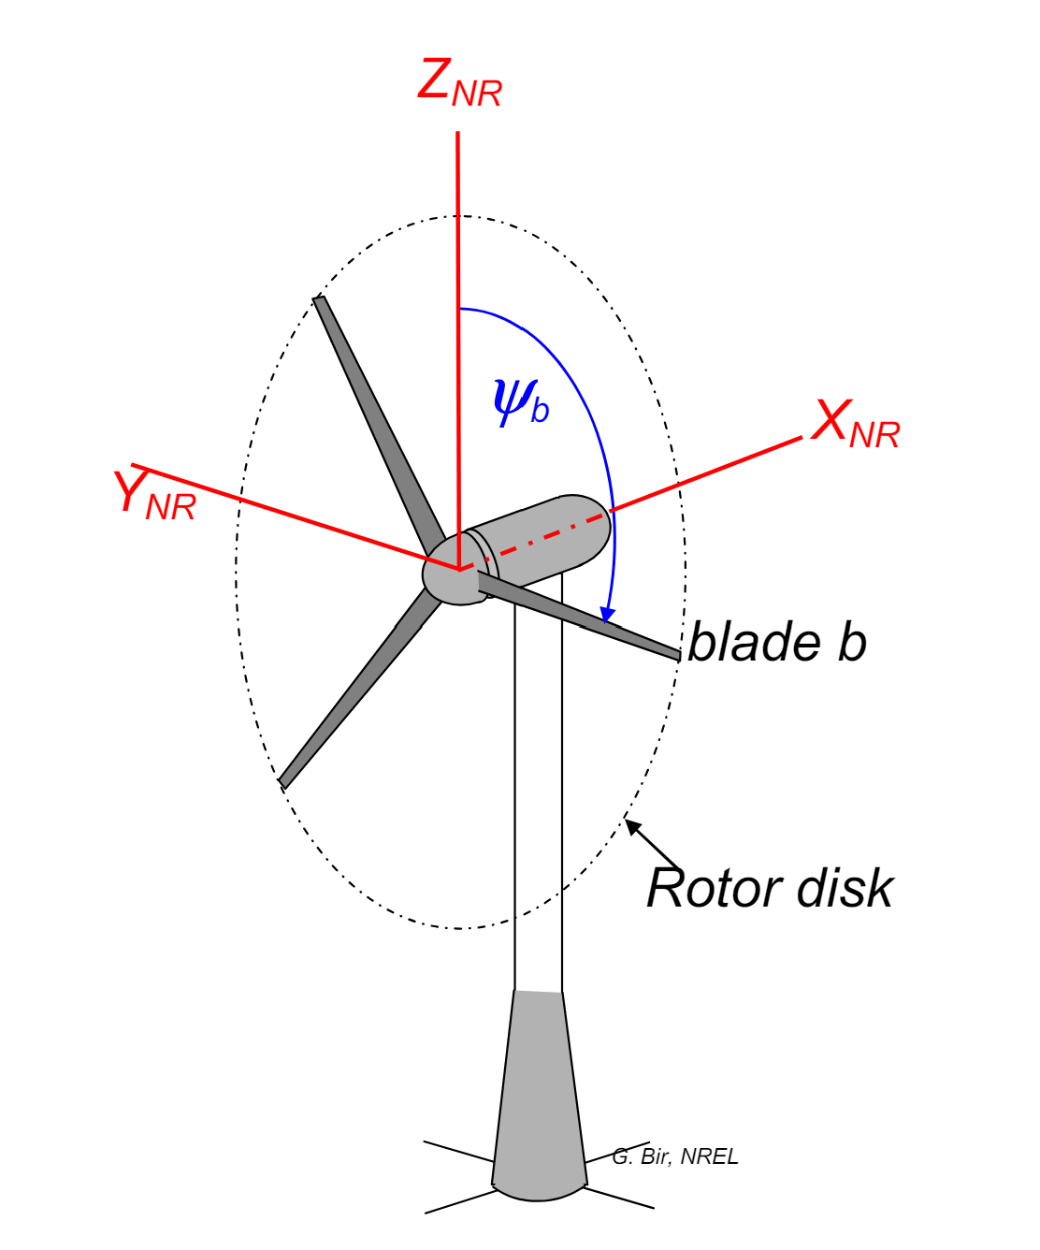
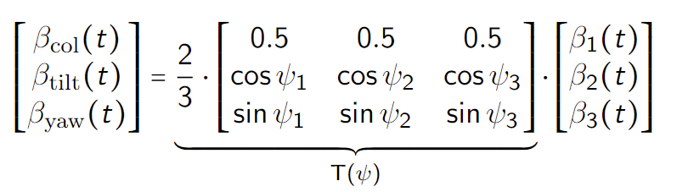
Helix Approach --- MBC Transform
Rotating Frame → Non-rotating Frame
Notes:
MBC transform map the signals from rotating frame to the non-rotating one.
In this fixed frame, the individual pitch commands can be computed as decoupled collective, tilt, and yaw pitch commands respectively, allowing simple SISO control loops instead of MIMO

Slide 9
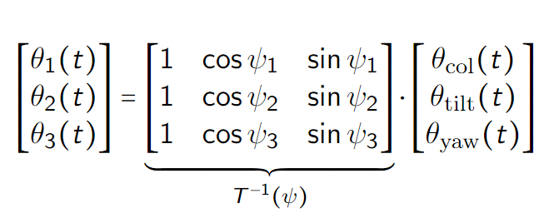
Helix Approach --- Inverse MBC Transform
Non-rotating Frame → Rotating Frame
Notes:
By using the inverse MBC, we just need to give the tilt and yaw moment, then the blade pitch signals are acquired.

Slide 10
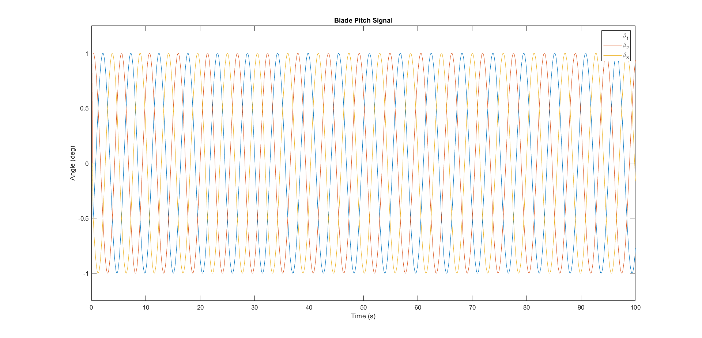
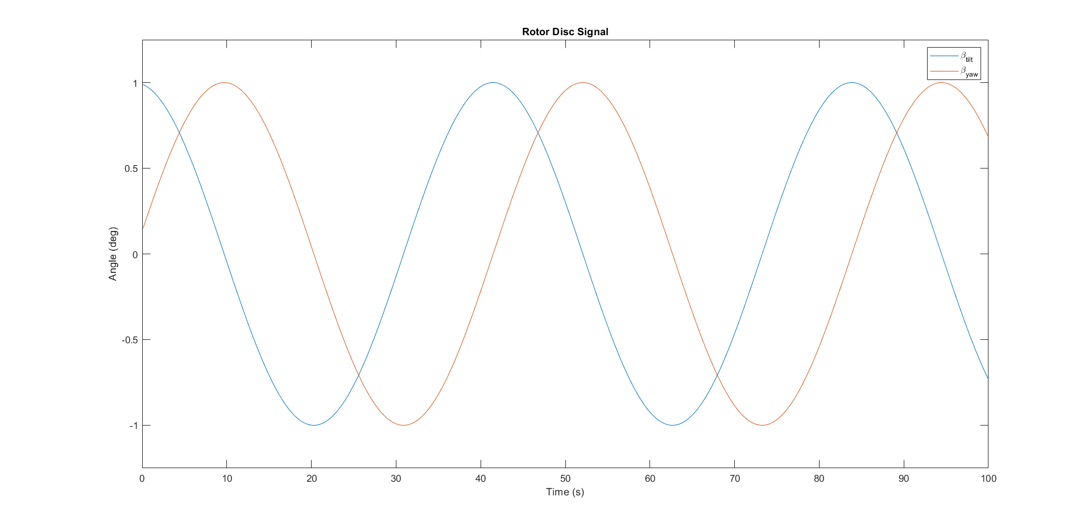
Helix Approach --- Transform
MBC
Inverse MBC
Notes:
MBC transform map the signals from rotating frame to the non-rotating one.
In this fixed frame, the individual pitch commands can be computed as decoupled collective, tilt, and yaw pitch commands respectively, allowing simple SISO control loops instead of MIMO

Slide 11
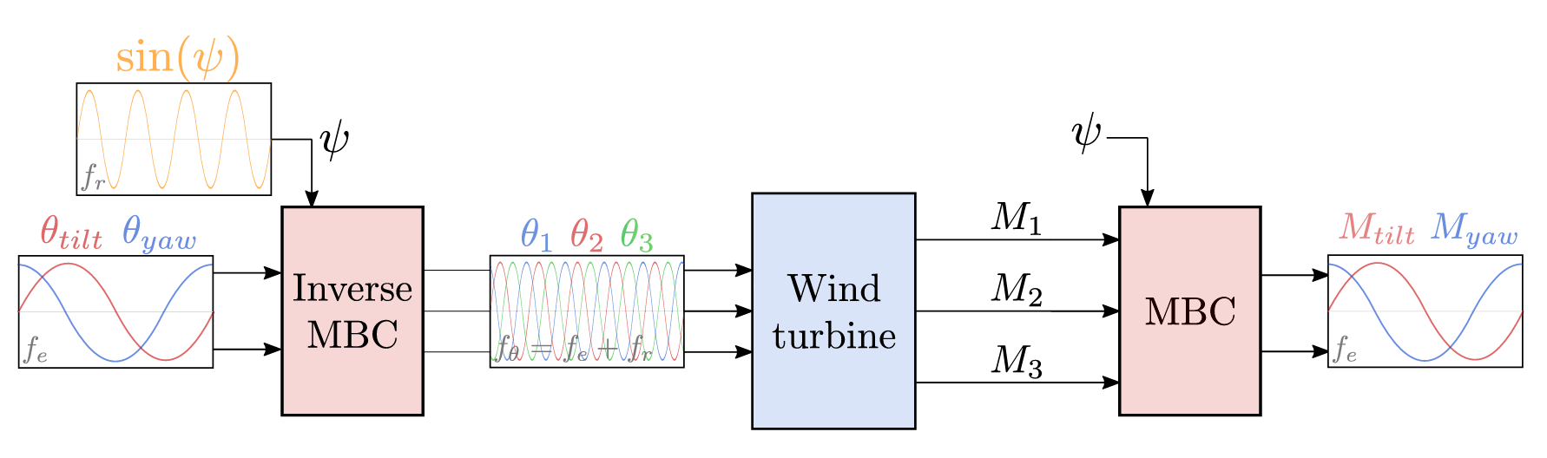
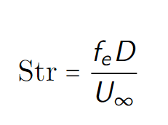
Helix --- Block Diagram
Sinusoidal signals
Frequency
Amplitude
Phase
Notes:
Beta(tilt) and Beta(yaw) for rotor disk, based on the phase different of tilt and yaw, the helix is clockwise or counterclockwise

Slide 12
Helix --- My Question
Open-Loop Control:
No feedback from output
Can we closed-loop control the helix based on flow information?
Notes:
Disturbance Rejection
Accuracy and Precision
Input-based control vs. Output-based control: Directly monitors and adjusts the system outputs.

Slide 13
Chapter | dark mode
01
Feedback
LiDAR

Slide 14
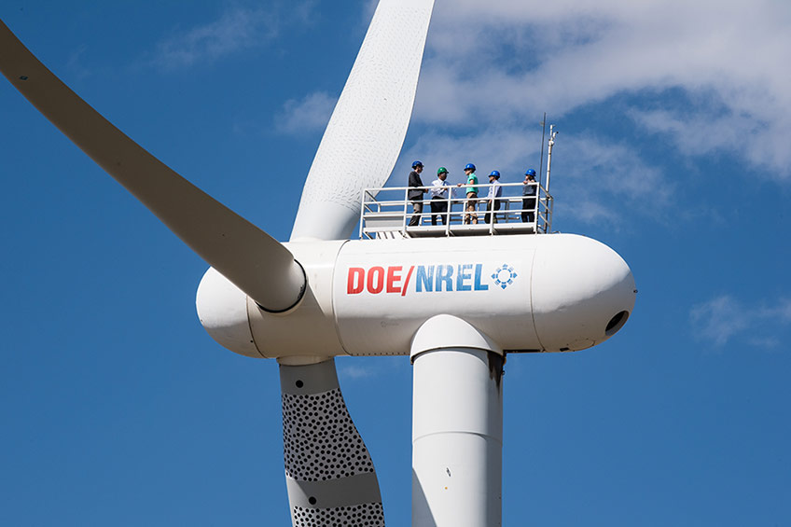
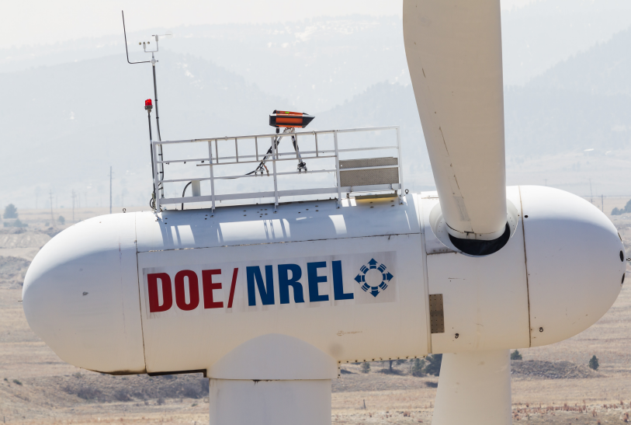
Feedback --- LiDAR
Notes:
To close the loop, one of the most important things is to get the feedback --- LiDAR

Slide 15
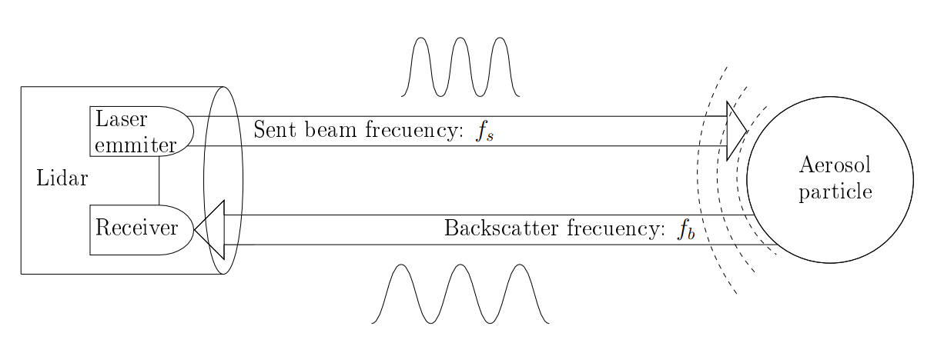
Feedback --- LiDAR Doppler Effect

Slide 16
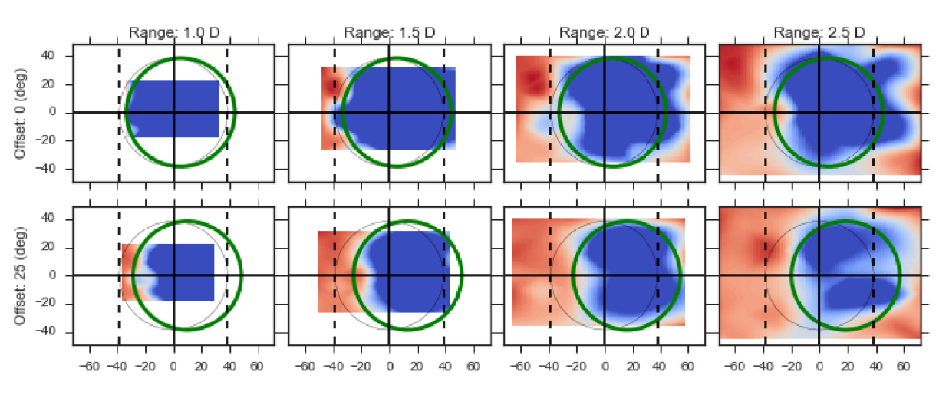
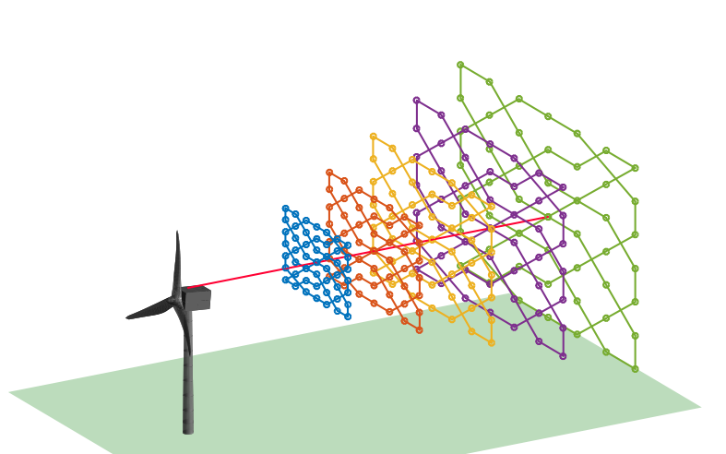
Feedback --- LiDAR Application WFFC
Notes:
Wake steering
Bring the question: can we use this setup for controlling the helix?

Slide 17
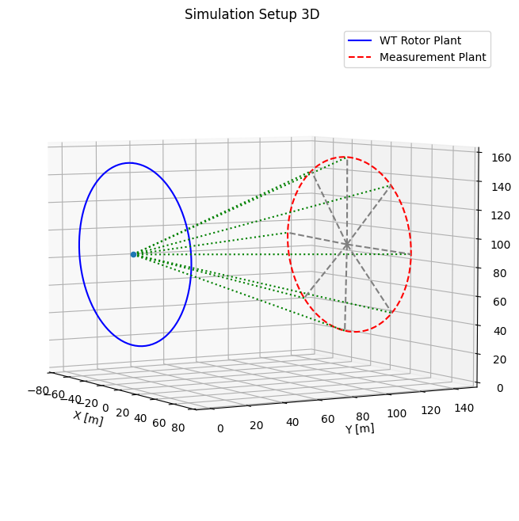
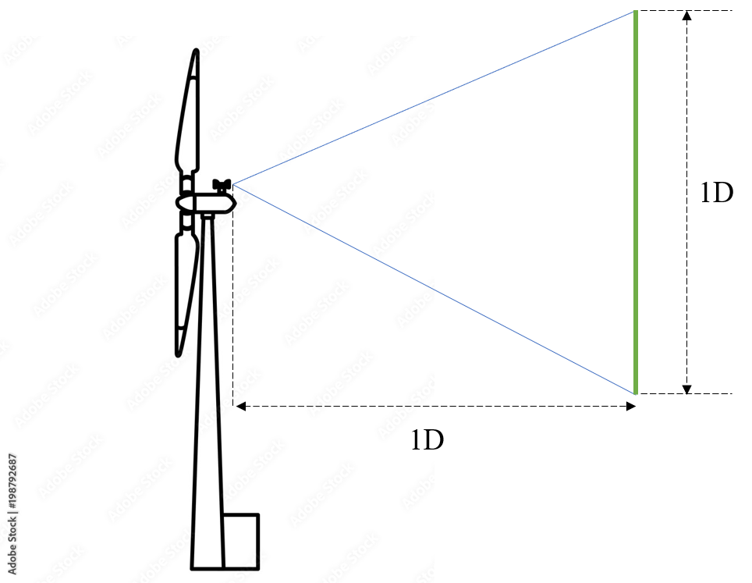
Feedback --- Simulation Setup
Continuous Wave LiDAR
Notes:
Downwind facing CW LIDAR
Measuring 1D (rotor disk) position
Information of the whole plant can be acquired

Slide 18
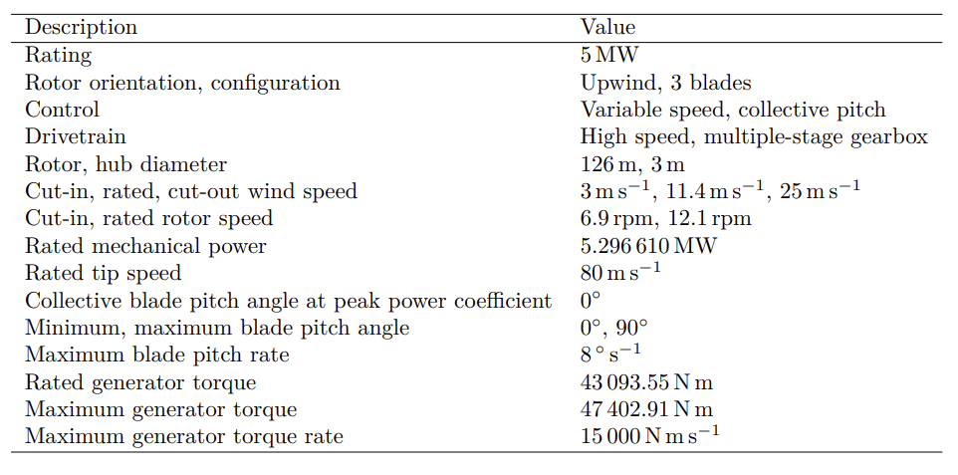


Feedback --- Practical Tool
Notes:
Q-blade
MATLAB
NREL5MW

Slide 19
Chapter | dark mode
02
Research Question
When pieces become a full puzzle
Notes:
First look at what LiDAR brings

Slide 20
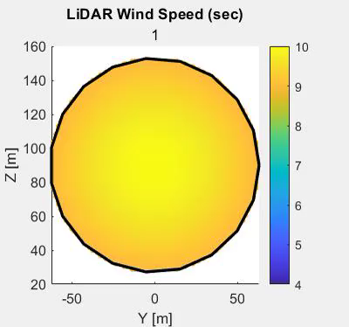
RQ --- A Look into Data
U = 10 m/s
CCW
Str = 0.3
Amplitude = 3
Notes:
Q-blade doesn’t have any LiDAR functionality, so I spent around a week time to implement the LiDAR functionality and optimize it so that it’s fast enough (2 days --> 10 mins --> 2 mins )
Wake center is what I am aiming at
1. obvious
2. accessible in real-time

Slide 21
RQ --- Questions
How to integrate LiDAR and the helix approach for closed-loop wake mixing control for wind farms?
Which LiDAR configuration to use?
What feature in the wake should be controlled?
How to design the control loop to rectify the helix?
Potential for next step?

Slide 22
Chapter | dark mode
03
Control Design
A thing I am supposed to be good at

Slide 23
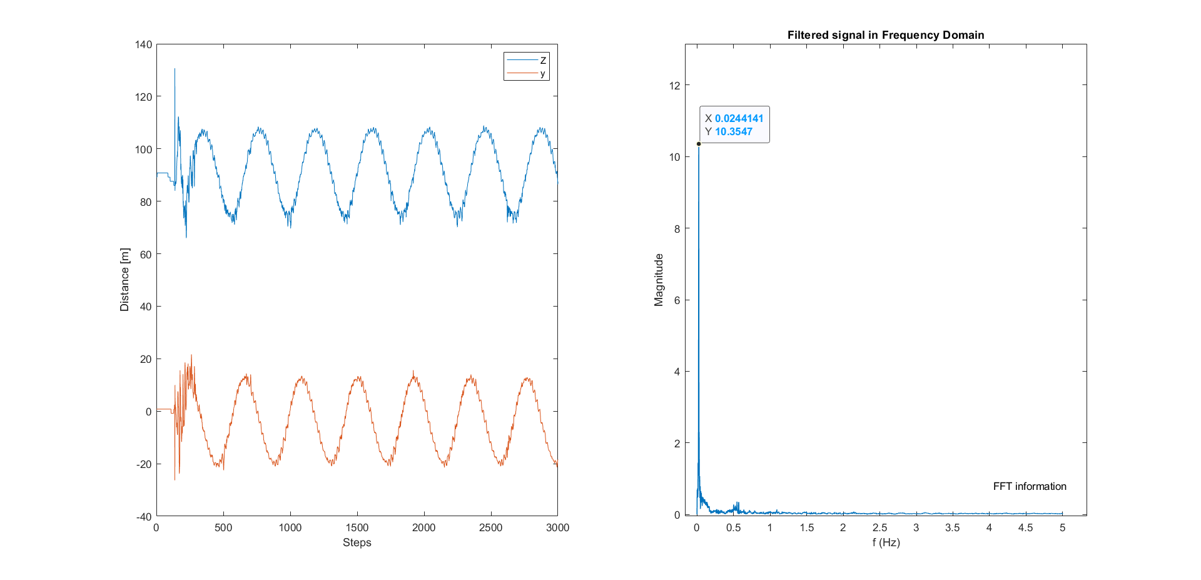
Control Design --- Helix Center
Notes:
CCW, coordinate of helix center, two periodic signal

Slide 24
Control Design --- New Transform
Rotating Frame → Non-Rotating Frame
fr+fe → fe

Slide 25
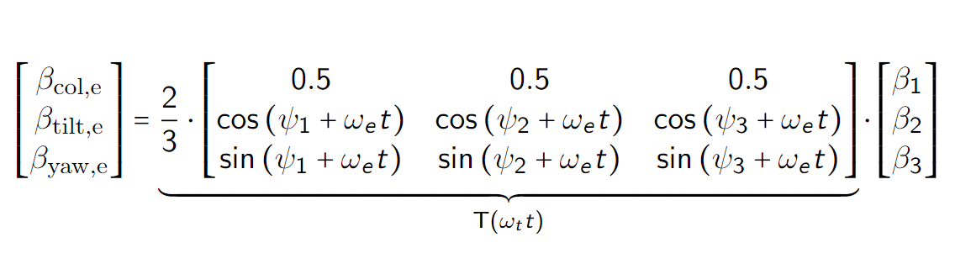
Control Design --- New Transform
Rotating Frame → Non-Rotating Frame → Helix Frame
fr+fe → fe
fr+fe → fe → 0P

Slide 26
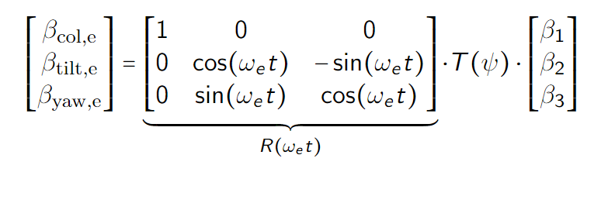
Control Design --- New Transform
Rotating Frame → Non-Rotating Frame → Helix Frame
fr+fe → fe
fr+fe → fe → 0P

Slide 27
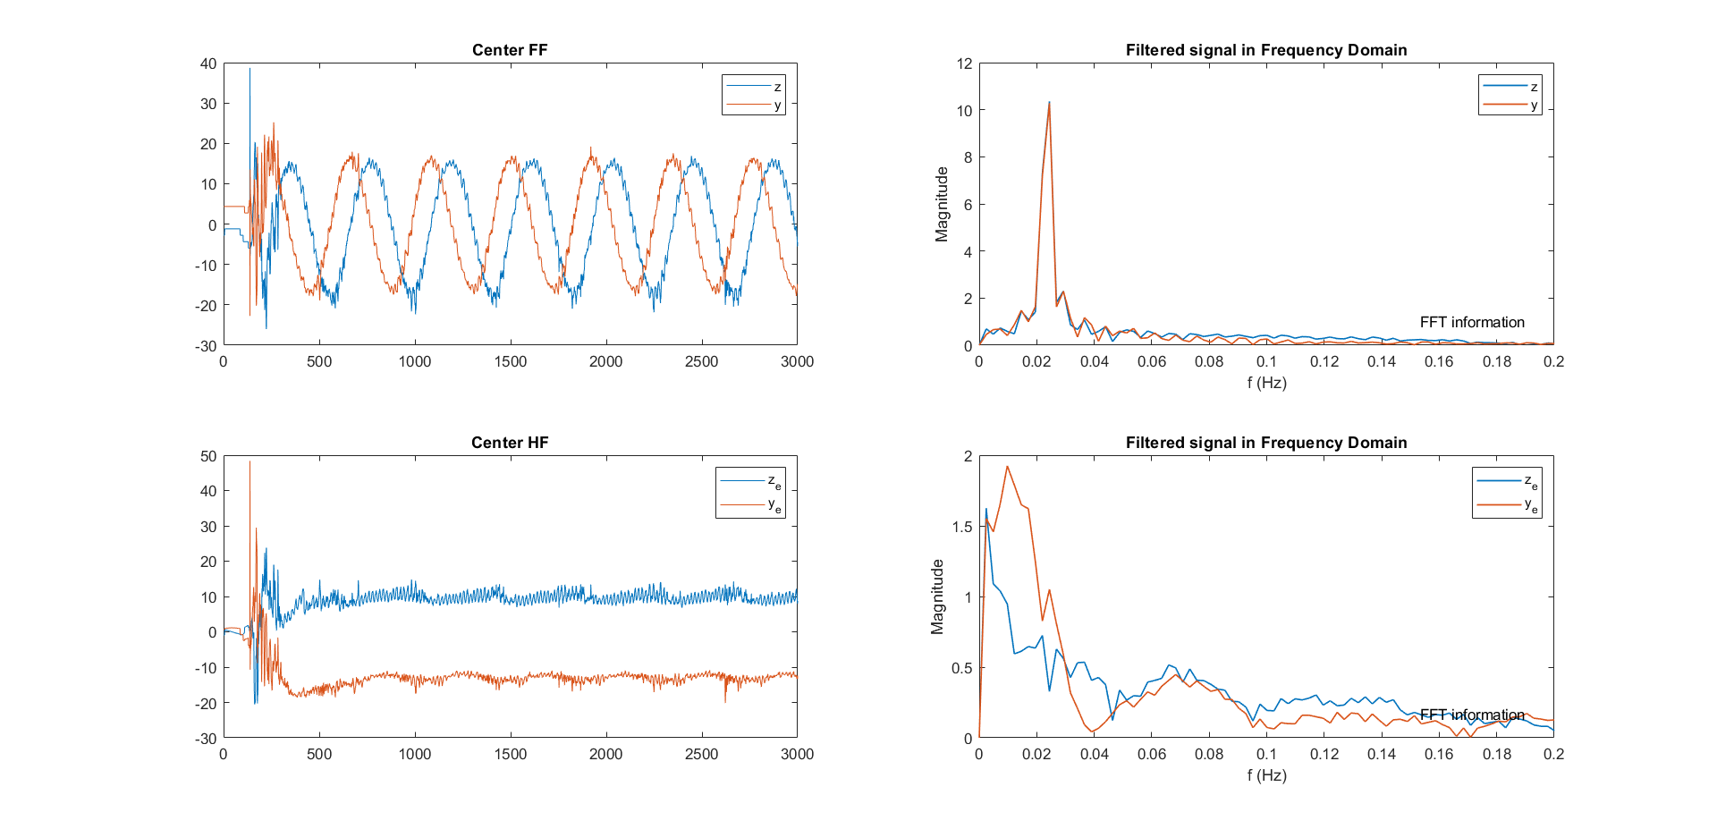
Control Design --- New Transform
Fixed Frame
Helix Frame

Slide 28
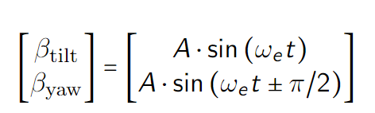
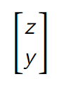
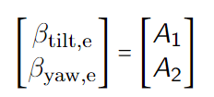
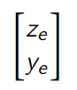
Control Design --- Relationship Map
Fixed Frame
FF beta
FF center
Helix Frame
HF beta
HF center
Notes:
There are four different combination that can be controlled
We explore the relation between input and output by first open-loop control the whole system

Slide 29
Control Design --- Lookback
How to integrate LiDAR and the helix approach for closed-loop wake mixing control for wind farms?
Which LiDAR configuration to use? √
What feature in the wake should be controlled? √
How to design the control loop to rectify the helix?
Potential for next step?
Notes:
So here, we answered the first question, what configuration of LiDAR to be used.

Slide 30
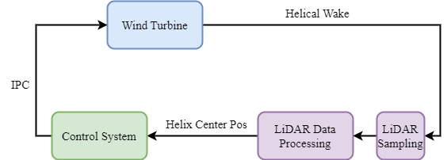
Control Design --- Overall Design
√
√
Notes:
Dead-time Delay

Slide 31
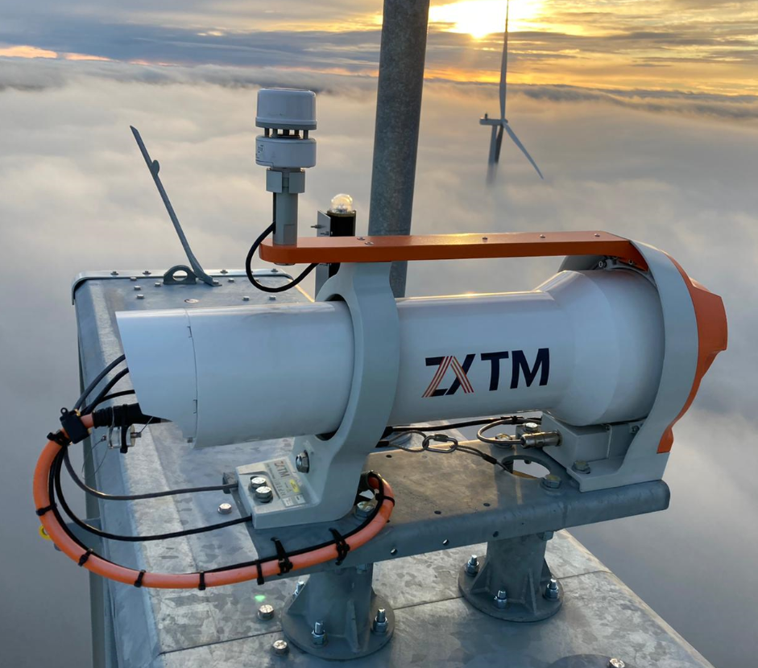
Control Design --- Analysis
LiDAR Data Processing Pipeline
Calculate Helix Center
Coordinate Transform
Filter
Control
Handle Output Delay

Slide 32
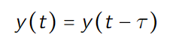
Control Design --- Deadtime Delay
Notes:
Dead-time Delay

Slide 33
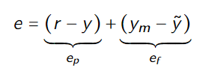
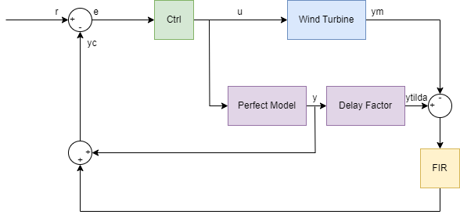
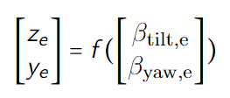
Control Design --- Smith Predictor

Slide 34
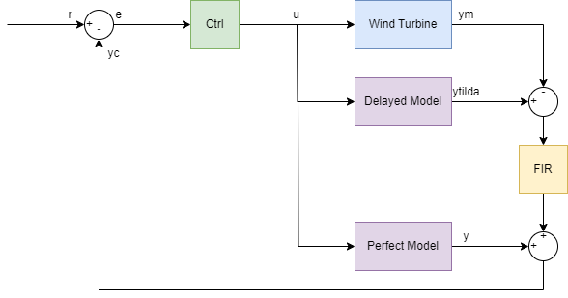
Control Design --- Smith Predictor
A perfect model
A delayed model
A filter
MIMO/SISO controller(s)
Close the loop in real-time

Slide 35
Chapter | dark mode
04
Current Progress
To prove that I’m not wasting time

Slide 36
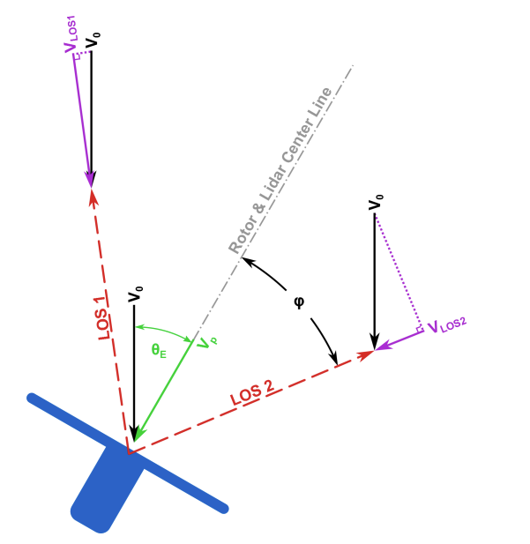
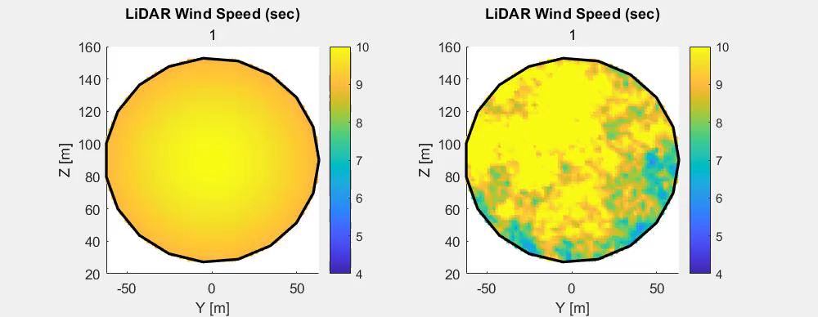
Current Progress --- LiDAR Sampling
Notes:
Fast computation, able to run real-time, use the GPU

Slide 37
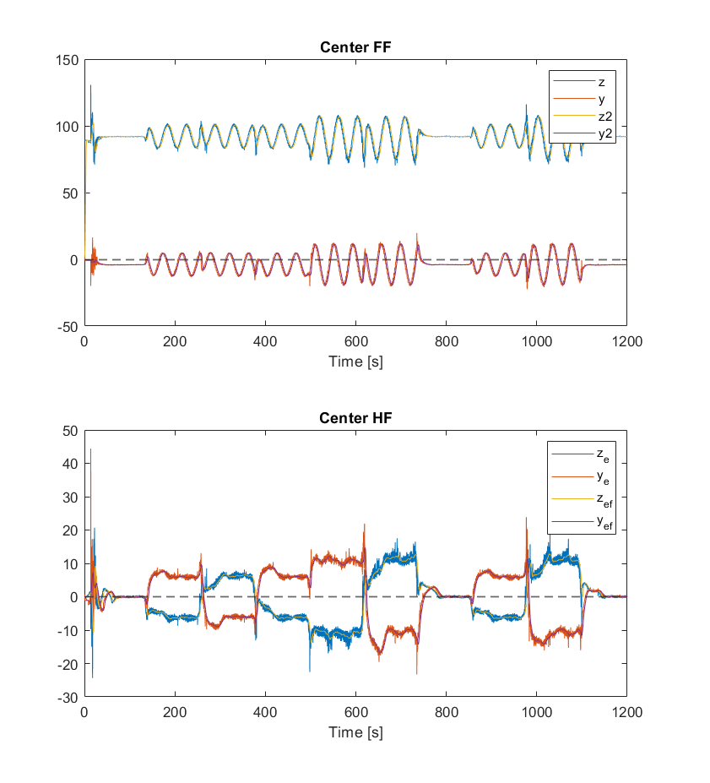
Current Progress --- LiDAR Data Processing
Start
Sim Over
Y
N
LiDAR sampling
Helix Center Calculation
LPF
Detrend
Coordinate Transfer
Over

Slide 38
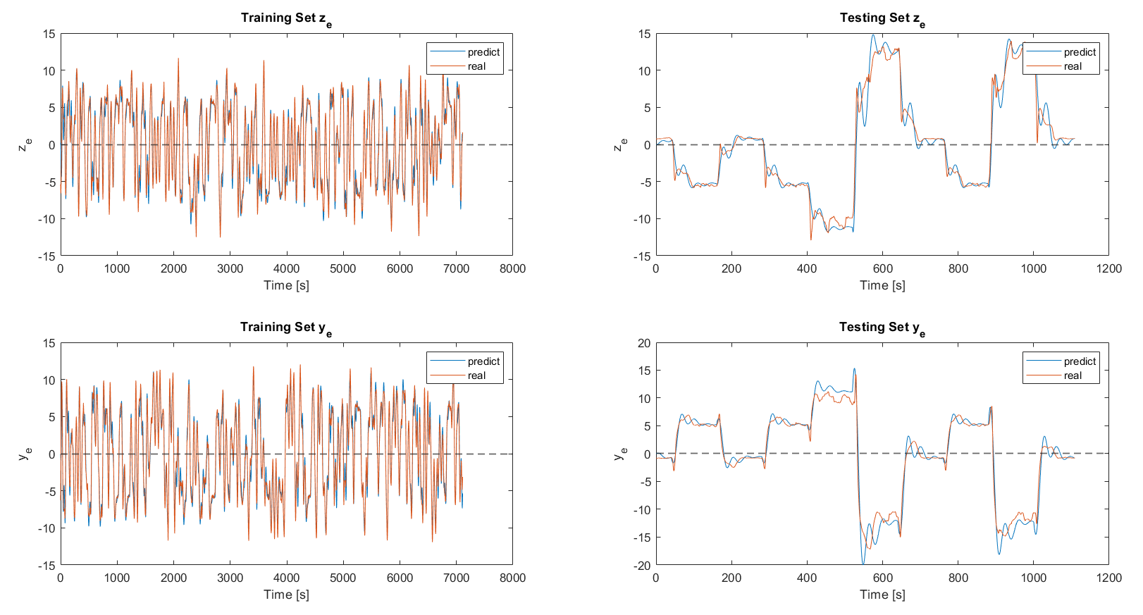
Current Progress --- Internal Model IDE

Slide 39
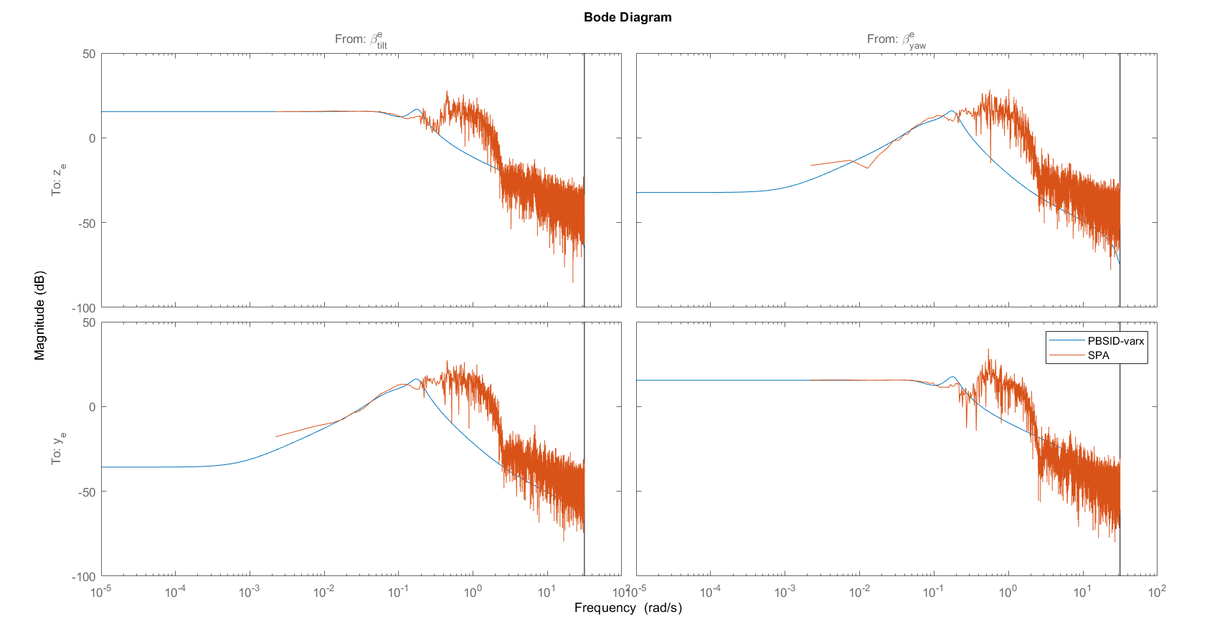
Current Progress --- Internal Model IDE
Notes:
Decouple

Slide 40

Current Progress --- Internal Model IDE
Result VAF
Analysis
Linearity!
Controllable & Observable
Steady-state decouple thanks to Azimuth Offset
 | Train Data | Test Data
Z | 96.5054 | 96.0452
Y | 96.5626 | 95.5183

Slide 41
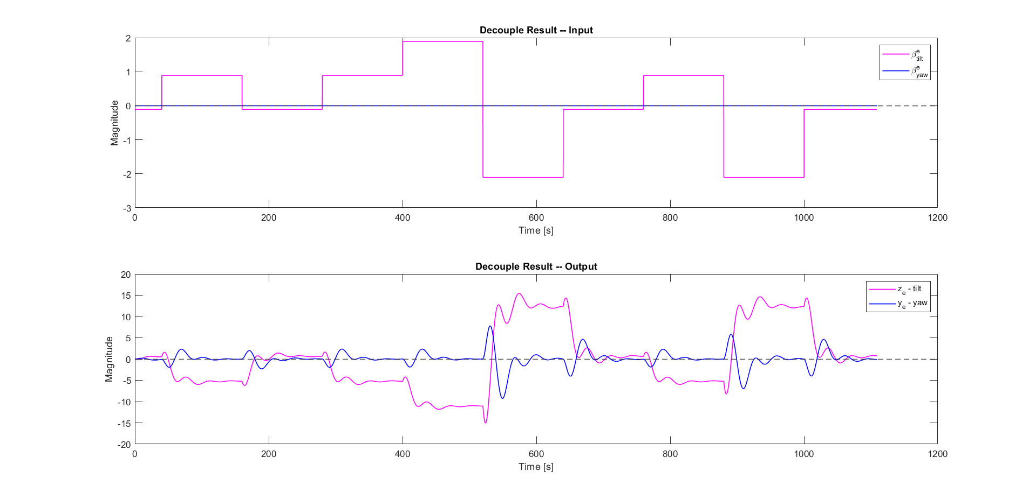
Current Progress --- Internal Model IDE
Notes:
Decouple

Slide 42
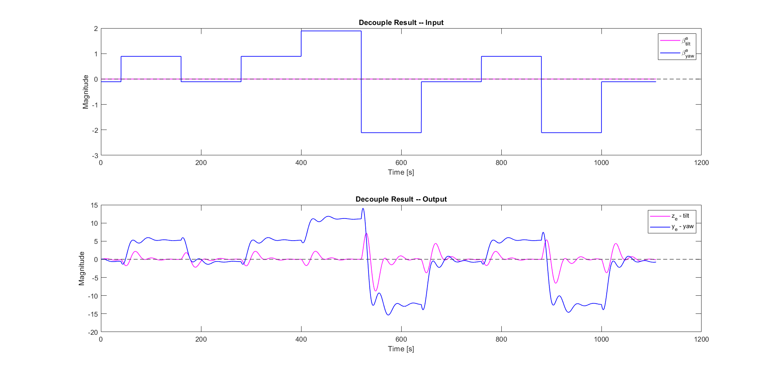
Current Progress --- Internal Model IDE
Notes:
Decouple

Slide 43
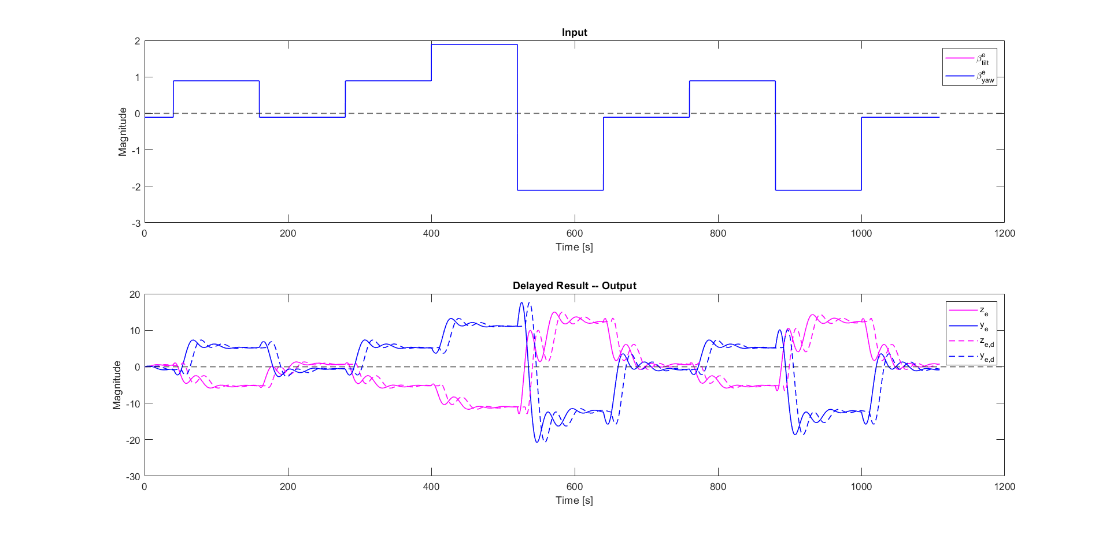
Current Progress --- Delayed Model
Notes:
Decouple

Slide 44
Chapter | dark mode
05
Future Work & Challenges
Journey ahead

Slide 45
Challenge & FW --- Internal Model IDE
Result VAF
Analysis
Linearity!
Stability!
Steady-state decouple thanks to Azimuth Offset
High frequency does not capture well
 | Train Data | Test Data
Z | 96.5054 | 96.0452
Y | 96.5626 | 95.5183

Slide 46
Future Work
Close the loop
Controller design based on internal model (Loop shaping
Gust and Turbulence
Open to suggestion :)

Slide 47
Thanks for listening :)

Slide 48
Chapter | dark mode
06
Q&A
Bring it in

Slide 49
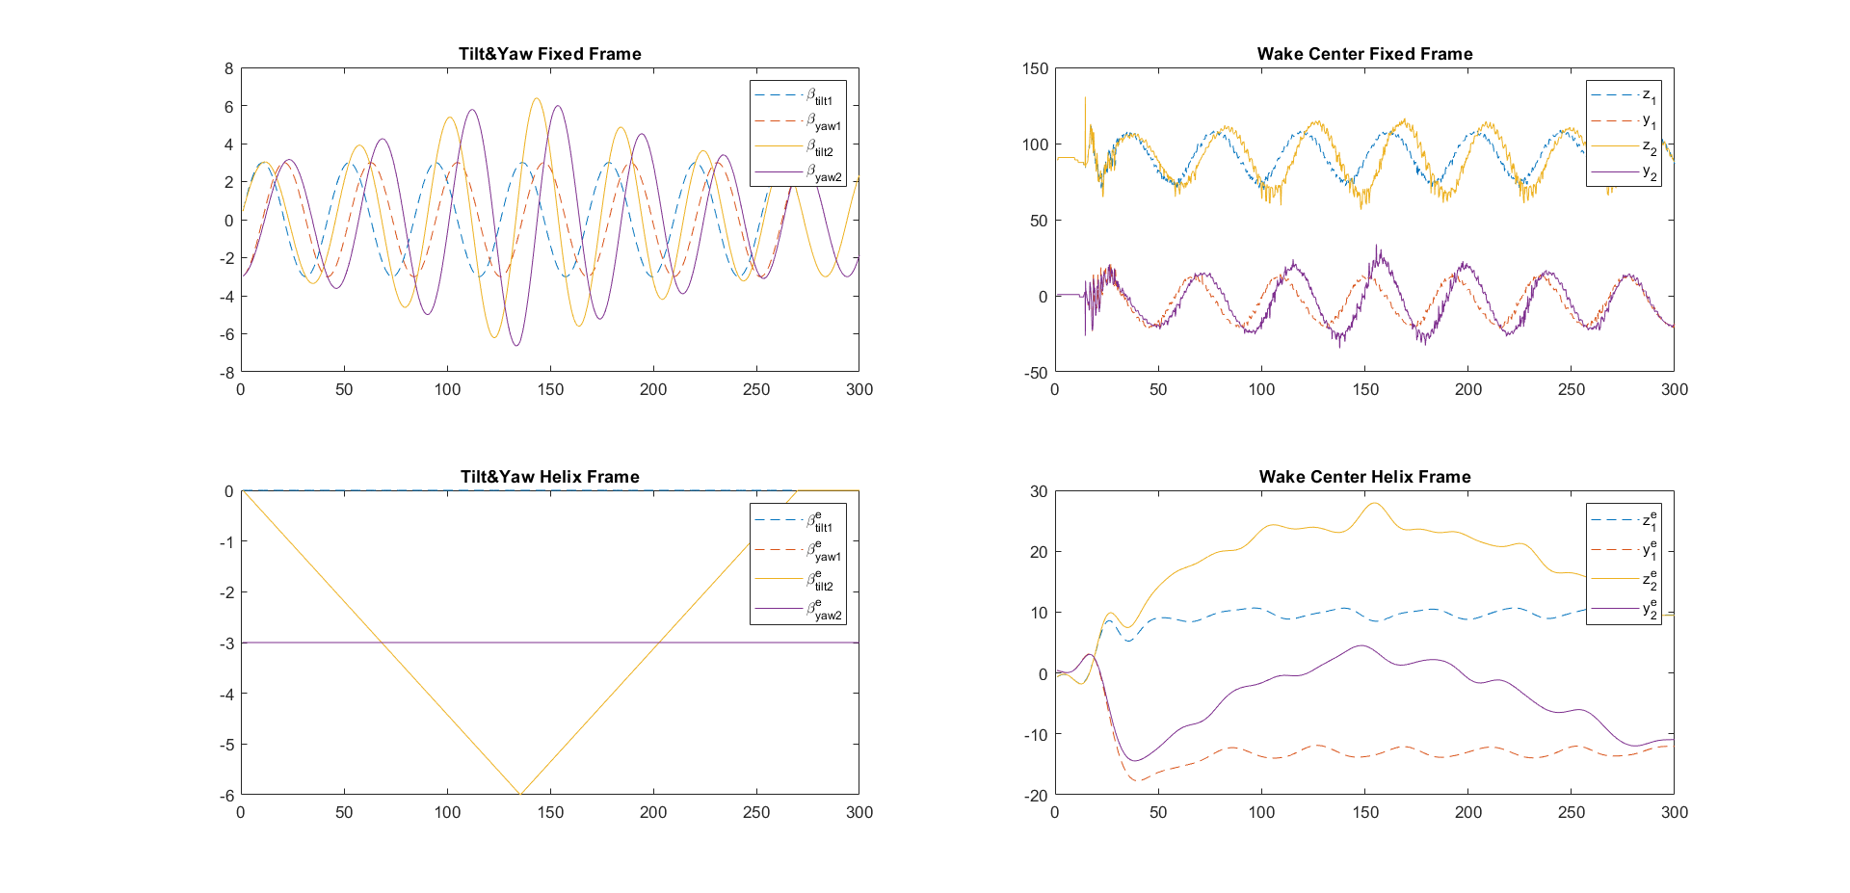
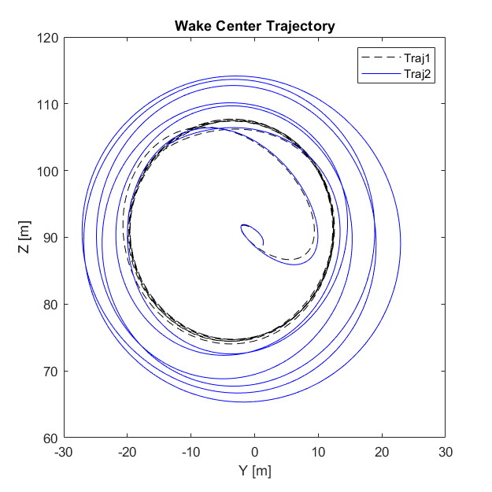
HF theta – HF center
Notes:
First the magnitude of beta tilt and beta yaw

Slide 50
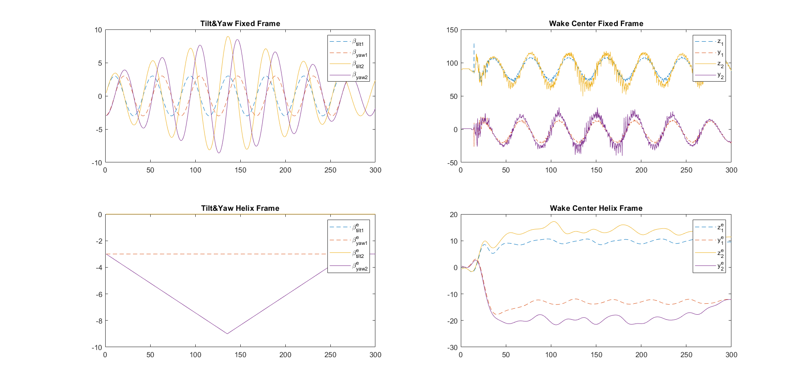
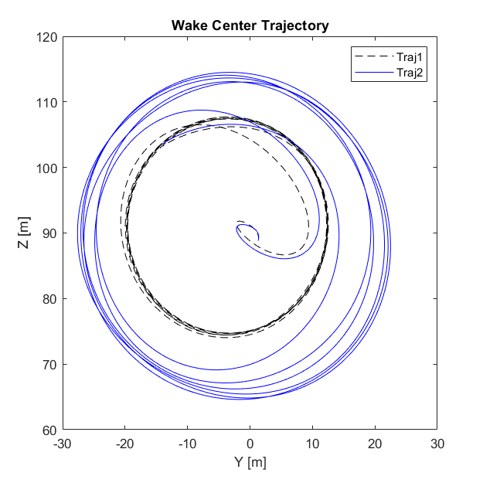
HF theta – HF center
Notes:
First the magnitude of beta tilt and beta yaw

Slide 51
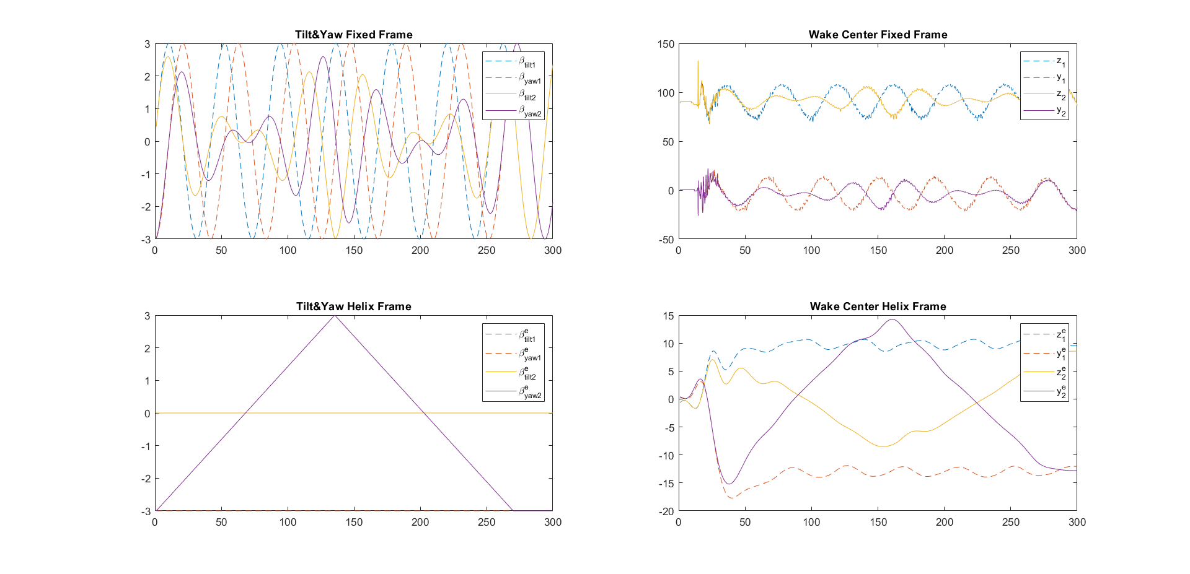

HF theta – HF center
Notes:
First the magnitude of beta tilt and beta yaw

Slide 52


HF theta – HF center
Notes:
First the magnitude of beta tilt and beta yaw

Slide 53

Feedback --- LiDAR
Notes:
LiDAR is placed in the perfect location --- 1.86D for IEA15MW so that the diameter of the ring is the same as D

Slide 54


Slide 55
LiDAR Choosing
Trade off between practicality and quality --- Modified ZX-TM LiDAR
Continuous Wave LiDAR
Measure Distance: 10 – 720 m
Half-cone angle: -
Entire rotor disk

Slide 56


Slide 57

New Transform

Slide 58
System IDE
Notes:
Dead-time Delay

Slide 59

Deadtime Delay

Slide 60



Smith Predictor
Notes:
Equations of internal model and delay.
The internal model predict the reaction of the wake to the demanded yaw angle. The first equation is the relationship of yaw, and then the second one is for the wake.

Slide 61

Bode diagram System IDE

Slide 62
Comparison of outputs

Slide 63

Model Precision

Slide 64

Comparison of outputs
Notes:
Y is the dominate one compared to Yc

